Slide 1

SharePoint Search 2013 Basics
What is Search in SharePoint 2013?
Search Components in SharePoint 2013
Search Service Application Creation
Search Service Database’s
Content Source
Crawling Type
Crawled and Managed Property
Adding and configuring Search Result Web Part
Customization on Search Content Source (KQL AND FQL)
Problems with Search Service Application
SharePoint Development Team - RCP 3C Grd Flr

Slide 2
What is Search in SharePoint 2013?
Search in SharePoint 2013 is one of most powerful and user friendly feature which enables users to find relevant information more quickly and easily than ever before and makes it easy for Search administrators to customize the search experience. It also provides several API sets for more advanced customizations and solutions. Now in SharePoint 2013 user can fetch data from various Content Source Type. All this can be done with simple Query Rules, Result Sources and other new feature of the SharePoint Search Service.
Search Components:
Crawl Component
Content Processing Component
Analytics Processing Component
Index Component
Query Processing Component
Search Administration Component
SharePoint Development Team - RCP 3C Grd Flr

Slide 3
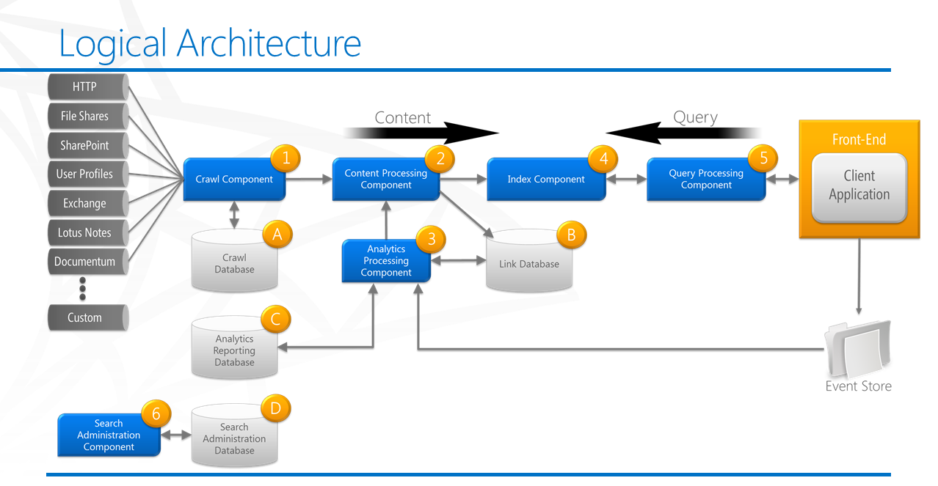
Search Service Component Architecture
SharePoint Development Team - RCP 3C Grd Flr

Slide 4
Crawl Component:
The crawl component crawls the content sources. You can crawl lots of content sources, for example file shares, SharePoint content, line of business applications and many more. To retrieve information, the crawl component connects to the content sources by invoking the appropriate indexing connector or protocol handler.
Content Processing Component:
The content processing component processes crawled items and sends these items to the index component. The content processing component performs operations such as document parsing and property mapping
Analytics Processing Component:
  The analytics processing component performs two types of analyses: search analytics and usage analytics.
  Search analytics is about extracting information, such as links, the number of times an item is clicked, anchor text, data related to people, and metadata, from the link database. This information is important to relevance. Its also perform various analysis such as Anchor text Processing (how items in the content are interlinked), Click Distance (no. of clicks between an page), Search Clicks and Search Reports (Top Queries, Number of Queries, Abandoned Queries etc).
  Usage analytics is about analyzing usage log information received from the front-end via the event store. Usage analytics generates usage and statistics reports. It also performs various analysis such as Usage Counts (viewed or clicked items), Recommendations (how users have interacted with item), Activity Ranking etc.
SharePoint Development Team - RCP 3C Grd Flr

Slide 5
Index Component:
The index component is the logical representation of an index replica. In the search topology, you have provision to add one index component for each index replica. The index component Receives processed items from the content processing component and writes those items to an index file. Index files are stored on a disk in the server that hosts the index component. It also Receives queries from the query processing component and returns result sets.
Query Processing Component
The query component analyzes and processes queries and results. It performs linguistics processing such as word breaking and stemming. When the query processing component receives a query from the search front-end, it analyzes and processes the query to optimize precision, recall and relevance.
Search Administration Component
  The search administration component runs the system processes for search. This component performs provisioning, which is to add and initialize instances of the other search components.
SharePoint Development Team - RCP 3C Grd Flr

Slide 6
Search Service Creation
On the Central Administration home page, in the Application Management section, click Manage service applications.
On the Manage Service Applications page, on the ribbon, click New, and then click Search Service Application.
On the Create New Search Service Application page, do the following:
  Accept the default value for Service Application name, or type a new name for the Search service application.
  In the Search Service Account list, select the managed account that you registered in the previous procedure to run the Search service.
  In the Application Pool for Search Admin Web Service section, do the following:
    Select the Create new application pool option, and then specify a name for the application pool in the Application pool name text box.
    In the Select a security account for this application pool section, select the Configurable option, and then from the list select the account that you registered to run the application pool for the Search Admin Web Service.
  In the Application Pool for Search Query and Site Settings Web Service section, do the following:
    Choose the Create new application pool option, and then specify a name for the application pool in the Application pool name text box.
SharePoint Development Team - RCP 3C Grd Flr

Slide 7
    In the Select a security account for this application pool section, select the Configurable option, and then from the list select the account that you registered to run the application pool for the Search Query and Site Settings Web Service.
Configure the SharePoint Search service application
You configure a Search service application on the Search Administration page for that service application. Use the following procedure to go to the Search Administration page for a particular Search service application.
To go to the Search Administration page
1. Verify that the user account that is performing this procedure is an administrator for the Search service application that you want to configure.
2. On the home page of the Central Administration website, in the Application Management section, click Manage service applications.
3. On the Manage Service Applications page, click the Search service application that you want to configure.
On the Search Administration page, configure the settings as described in the following sections:
• Specify the default content access account
• Specify the contact email address
• Create content sources
SharePoint Development Team - RCP 3C Grd Flr

Slide 8
Search Service Database
Crawl Database:
The crawl database stores tracking information and details about crawled items. For example, it stores information about the last crawl time, the last crawl ID and the type of update during the last crawl.
Link Database:
The link database stores information extracted by the content processing component. It also stores information about the number of times people have clicked on a search result. The information is stored unprocessed; the analytics processing component performs the analysis.
Analytics Reporting Database:
The analytics reporting database stores the results of usage analytics and extracts information from the link database when it is required.
Search Administration Database:
The search administration database stores search configuration data and the access control list (ACL) for the crawl component. There can be only one search administration database per search service application.
SharePoint Development Team - RCP 3C Grd Flr

Slide 9
Content Source
A content source is a set of options that you use to specify what, when, and how to crawl.
When a Search service application is created, a content source named "Local SharePoint sites" is automatically created and configured for crawling all SharePoint sites in the local server farm. You can create additional content sources to specify other content to crawl and how the system should crawl that content. After you create a content source, you can edit or delete it at any time.
Below are the crawl type that we can crawl with SharePoint:
  HTTP (Web Content)
  File Share
  SharePoint
  User Profiles
  Exchange
  Lotus Note
  Custom Connectors (BCS)
SharePoint Development Team - RCP 3C Grd Flr

Slide 10
Crawling
To make sure that the content should be available to the user we need to crawl the content by using one of the crawling type as mentioned below:
1. Full Crawl:
  Crawl Full Items
  Can be scheduled
  Can be stop and paused
  When required
    Change content access account
    Added new manage properties
    Content enrichment web service codes change/modified.
    Add new IFilter
SharePoint Development Team - RCP 3C Grd Flr

Slide 11
Incremental Crawl:
  Crawl last modified content
  Can be scheduled
  Can be stop and paused
Continues Crawl
  Index as current as possible.
  Cannot be scheduled
  Cannot be stop and paused (Once started, a “Continuous Crawl” can’t be paused or stopped, you can just disable it.)
  Works only with the SharePoint Content.
  Can run simultaneously.
SharePoint Development Team - RCP 3C Grd Flr

Slide 12
  When required
    Content frequently changed (Multiple instance can be run in parallel).
    Only for SharePoint Content Source
SharePoint Development Team - RCP 3C Grd Flr

Slide 13
Crawled and Managed Property
Crawled Property
  A crawled property is content and metadata that is extracted from an item, such as a document or a URL, during a crawl. A crawled property can be an author, title, or subject. This means that it has passed over our columns and the metadata assigned to each element. We do not have any control over the creation of “Crawled Properties”. These are the list of results of columns crawled in some way, though we are over-simplifying it.
Managed Property:
  The Managed Properties is where it all happens. If we need anything to be search related: Search Results, Refiners, Display Templates, Content Search etc., then we will need to understand how to create and manage these “Managed Properties”.
  Each Managed Property is by default mapped to one or multiple “Crawled Properties”. Assume that our organization has many lists and libraries. In them, users (logged in Users) created columns like “Customer Name” and “Client
SharePoint Development Team - RCP 3C Grd Flr

Slide 14
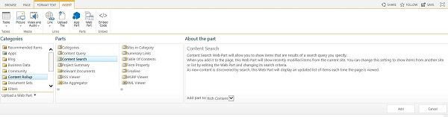
Adding and configuring Search Result Web Part
First step is to edit your SharePoint page and add the CSWP. This can be found in the Content Rollup.
2. To configure the web part, first click anywhere in the web part, then choose the Web Part tab in the ribbon. From that tab click Web Part Properties.
3. You will need to set up the query. To do so click Change Query from the web part properties box.
4. A Build Your Query dialog box will open. There are four tabs available — Basics, Refiners, Settings, Test. From the Basics tab you should see Switch to Advanced Mode in the upper right corner. If you see Switch to Quick Mode, click it. We will start with Quick Mode, which allows you to quickly create a query, select the scope, refine by metadata and add additional filters as needed
SharePoint Development Team - RCP 3C Grd Flr

Slide 15
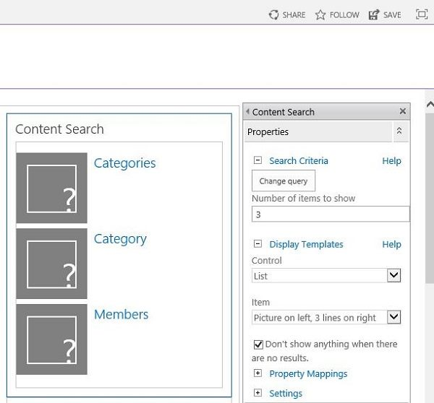
  The Select a query menu includes Documents, Items matching a content type, Items matching a tag, Items related to a current use, Pictures, Recently changed items, etc.
SharePoint Development Team - RCP 3C Grd Flr

Slide 16
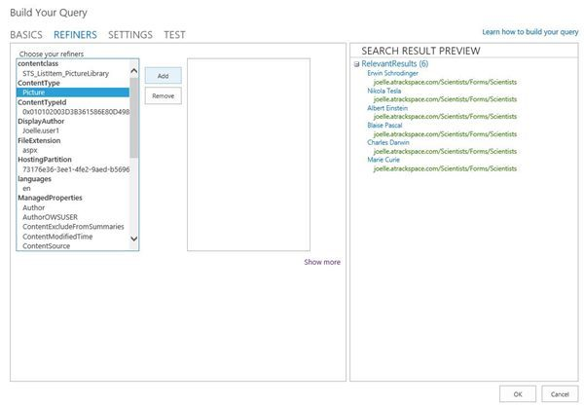
The Refiners tab allows you to filter your query even further.
For example, my query returned all items with the tag Scientist, which included documents in the results. If I was only searching for images, I could use this tab to refine the results by content type — Picture. This is also possible in the Quick Mode view, so one takeaway is that the query builder gives you several options for getting the results you need.
SharePoint Development Team - RCP 3C Grd Flr

Slide 17
Customization on Search Content Source (KQL AND FQL)
SharePoint search supports Keyword Query Language (KQL) and FAST Query Language (FQL) search syntax for building search queries.
Keyword Query Language (KQL)
KQL is the default query language for building search queries. Using KQL, you specify the search terms or property restrictions that are passed to the SharePoint search service.
FAST Query Language (FQL)
FQL is a structured query language that supports advanced query operators. You can use FQL when you want to create complex queries that you want to pass programmatically to the SharePoint search service. FQL isn't intended to be exposed to end users, and is disabled by default.
To enable FQL, use the EnableFQL property. Then, copy the default result source and modify the Query Transformation string {?{searchTerms} -ContentClass=urn:content-class:SPSPeople}, at one of these levels -- Search Service Application (SSA), Site Collection, or Site -- and in one of the following ways:
Remove the KQL filter, -ContentClass:urn:content-class:SPSPeople, from the Query Transformation. The resulting Query Transformation string will be: {?{searchTerms}}
Replace the Query Transformation string with an FQL equivalent, such as {?andnot({searchTerms},filter(contentclass:"urn:content-class:SPSPeople*"))}.
SharePoint Development Team - RCP 3C Grd Flr

Slide 18
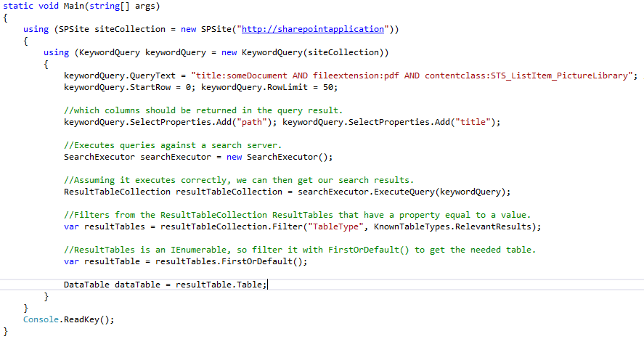
Customization on Search Content Source (KQL AND FQL)
  KQL Syntax:
SharePoint Development Team - RCP 3C Grd Flr

Slide 19
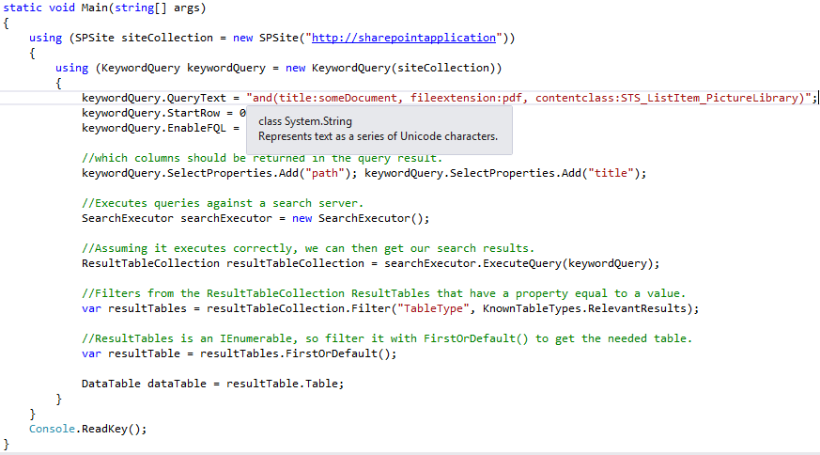
Customization on Search Content Source (KQL AND FQL)
  FQL Syntax:
SharePoint Development Team - RCP 3C Grd Flr

Slide 20
Common Issues
I have tried research for hours and cannot find a tutorial to show me how to do it. Maybe because the question seems too simple. However I have tried multiple times and keep doing wrong.
  We have 4 site collections:
  http://my.com/sites/A AND http://my.com/sites/B AND http://my.com/sites/C AND http://my.com/sites/D
In the Search Service Application web interface, I created a new content sources "Site A" with source type "Web sites".
I type in single entry "http://my.com/sites/A". Then I start a full crawl. By some reason, when I check crawl history, this content source crawl all 4 site collections A,B,C,D. I have applied another approach. I created another new content sources with source type "SharePoint", select "Only crawl the Site Collection of each start address", then type in single entry "http://my.com/sites/A". There is no different. It still crawl entire farm. (including items from A, B, C, D and people)
Solution : Upgraded the SharePoint server with Latest patch (QA).
2. Issues with Crawled Property.
  Result is not available according to the newly created columns.
  Solution: Ran Full Crawl on the effected Content Source and issue got resolved.
3. Newly added document/Item is not available in a search Result.
SharePoint Development Team - RCP 3C Grd Flr

Slide 21
References
Crawl Type: https://sapanjaiswal.wordpress.com/2014/01/03/types-of-crawl-in-sharepoint-2013/
Property Mapping in Search: https://technet.microsoft.com/en-IN/library/jj219667.aspx
Configure Search: http://www.sharepoint-journey.com/enterprise-search-configuration-in-sharepoint-2013.html
Issues: https://nhutcmos.wordpress.com/2016/01/15/sharepoint-2013-reset-index-partition-in-search-service-application/
Dev Central Admin (10.128.23.173): http://sidcsp13wfede02:2013/
Demo URL: DemoURLhttp://qaspweb5.ril.com/sites/admintest
Thank You
SharePoint Development Team - RCP 3C Grd Flr

